Slide 1



JIF CLAIMS COORDINATORS TRAINING SEMINAR
Presented by:
Chris Roselli, Patty Davidson,
Joe Lisciandri & Barbara MacLean

Slide 2

JIFs Proved to be a Better Way!
JIFs allowed municipalities to join together to take advantage of lower costs and additional services associated with self insurance and to achieve coverage and pricing
STABILITY!

Slide 3

Why JIF?
1. Why have so many N. J. Municipalities, Counties, MUA’s, Housing Authorities and School Boards made the JIF their choice for coverage and risk management services?
2. Why have so many stayed with the JIF?

Slide 4
The JIF is Different
Public Entity Ownership
Unparalleled Safety Programs
Solid Claims Management
Effective Risk Management
Customized Services
Financial Stability

Slide 5

JIF Concept
Towns put their money together
Expenses
Claims
Reinsurance
Benefits

Slide 6


Qual-Lynx Staff
Claims
  Intake
  Investigation
  Claim Adjudication
  Payments
Managed Care
  Intake
  Nurse Case Management
  Network

Slide 7

Claims Support
  Claims Coordinator
  Claims Personnel
  Fund Administrator
  Expert Defense Panel
  Fund Attorney
  Risk Management Consultant

Slide 8



MULTIPLE LINES OF
COVERAGE
Qual-Lynx handles multiple lines of coverage:
  Property: damage to municipal vehicles, equipment, or buildings.
  General Liability: bodily injury or property damage to a third party.
  Automobile Liability: bodily injury or property damage to a third party.
  Workers’ Compensation: your employees’ work related injury claims.

Slide 9


Role of The
Claims Coordinator

Slide 10

Role of the Claims Coordinator
The Claims Coordinator has the following responsibilities:
Coordinate prompt reporting of all claims within the municipality.
Maintain supply of claim forms.
Serve as a liaison between the municipality, TPA, and the MCO.
Direct injured employees to Panel Physician for initial medical evaluation. Follow-up with employee/claims adjuster/supervisor/ nurse case manager, as needed to track the progress of the claim.
Direct supervisors to “Incident Reports” on the JIF website; encourage completion within reasonable timeframe and transmit all reports as indicated.
Maintain records on all claims submitted.
Early, accurate claim reporting is essential to controlling the costs associated with your Workers’ Compensation, Liability and Property Damage programs.

Slide 11

PROPERTY
Damage to Owned Property & Vehicles
Including Contents and Equipment
Vandalism
Windstorm
Fire
Crime
Vehicle Damage

Slide 12
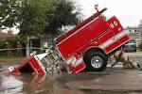
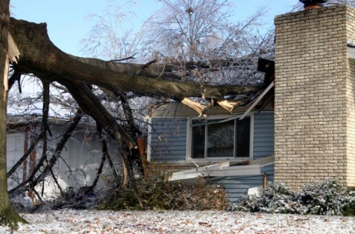

First Party
Property Claims
Fire, theft, vandalism, wind damage, lightning, flood
Automobile physical damage (your vehicles)
Any damage to insured property (i.e., owned buildings, contents, lighting, bleachers, park equipment, clothing, communications devices, fire rescue equipment, etc.)
Damage to backhoes or other off road equipment
Boiler and machinery losses
Damage to watercraft
Theft of funds

Slide 13
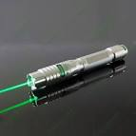

Property Pointers
Report the claim as soon as possible
  Even non-emergency claims should be reported.
  Enables the proper protection of the damaged and undamaged property involved in the loss.
  Quick reporting can assist in preserving any evidence that may exist to determine causation and for subrogation.
Provide as much information at the outset of the claim as possible.
  For example, knowing where a municipal vehicle is located and whether it is accruing storage can keep costs down.

Slide 14

Common Coverage Exclusions
  Long term events (rust, rotted materials, mold, pollution/contamination)
  Roadways, sidewalks, pavements
  Trees, bushes and shrubs
  General cleanup of streets, or extra costs related to increased curbside pick up of residents’ debris

Slide 15


What do you do?
Report the claim to Qual-Lynx at the earliest opportunity
The following is needed to start a claim:
a description of the loss
the location of the loss
the date of loss
contact person with contact information
Mitigate damages (start clean up, board up)
Timing is very important - delays can cost money and in some cases, coverage
Protect involved equipment. It may be evidence!

Slide 16

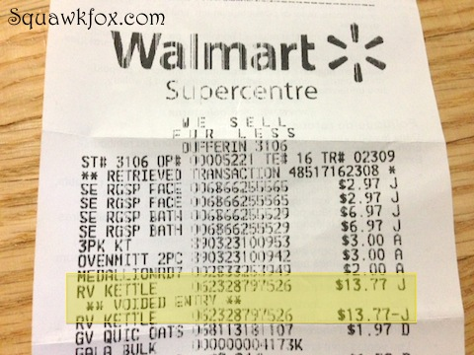
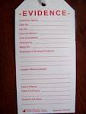

Please Remember
Keep all receipts - invoices, purchase orders and rental agreements
Evidence/spoliation
Take photos of anything about to be repaired/discarded
If uncertain about the next step, please contact our office

Slide 17

Vehicles and Salvage
Please take all damaged vehicles back to a secured yard owned by the municipality.
If the vehicle is driveable, it is not much of an issue. The vehicle can be driven to an auto body for an estimate and potentially still be in use.
If the vehicle is not driveable, it should not be taken to an auto body where it may accrue storage. Your choice of repairer should have no issues coming to you for an inspection.
If it is totaled, it is where it should be, and will remain there until the highest bidder for the salvage comes to pick it up.
If not totaled, the repairing shop will likely not charge for the tow(depending on vehicle size and condition).

Slide 18
What happens next?
Qual-Lynx will set up the claim. You will receive an acknowledgement letter from QL with the name of adjuster and claim number.
The adjuster will contact the insured for more details, address coverage, assign a vehicle appraiser, field adjuster, or expert.
If it appears that the claim will exceed the JIF limits, Qual-Lynx will place the MEL TPA on notice.
Once the claim has been settled and the insured has received payment, the adjuster may follow for subrogation proceeds if there is a negligent third party that contributed to or caused the loss to occur.

Slide 19
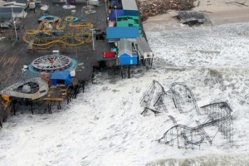

CATASTROPHIC CLAIMS
IMMEDIATE REPORTING IS CRITICAL
Secure the property involved considering the safety of employees, residents, etc.
Contact an Emergency Service Provider to prevent further damages or secure a building. The MEL Website www.njmel.org. provides a list of qualified emergency service providers. However, the member is not obligated to select a vendor from the list.
Report the claim to Qual-Lynx who will then report the claim to the designated Property Adjuster on the MEL level. The MEL TPA will then handle the claim.
For a catastrophic event, such as Hurricanes Irene and Sandy, you should contact FEMA no matter how small the claim may be.
FEMA website is www.FEMA.gov and phone number is 800-621-3362.

Slide 20


Things to think about
Do you have a plan in place?
  Please visit Ready.Gov/Business or Ready.Gov/Hurricanes
Remember, we are normally aware of hurricanes for weeks. Nor’easters do not have that kind of warning!
What important documents are you storing? Are they stored properly?
How about your computers/communication systems?
  What can you do to protect them?
  Lightning protection in place?
  Back them up and take info home
Does your generator have the capability to run the portions of the building you will need it to run?
  Is it running properly?
Flood policy required for any of your buildings?
Regular maintenance can prevent large exposures

Slide 21


Auto Physical Damage
ACV*
Comprehensive
Collision
JIF does not cover damage to volunteer autos!
  *Replacement cost on emergency transport vehicles under 15 years old, or that have been refurbished/restored in the last 15 years with Documentation showing restoration!

Slide 22

PROPERTY CONTACT INFORMATION
Joe Lisciandri, Prop. Claims Supervisor
Qual-Lynx
100 Decadon Drive
Egg Harbor Township, NJ 08234
609-653-8400 x. 3237
Cell Phone 609-402-5218
Property Dedicated Fax 609-601-3192
jlisciandri@qual-lynx.com
Eileen Stasuk, Senior Property Adjuster x2023 estasuk@qual-lynx.com
Jim Mercanto, Property Adjuster x2102 jmercanto@qual-lynx.com

Slide 23
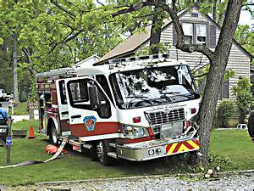

Auto Liability
Any Motor Vehicle Accident involving an insured vehicle which results in bodily injury and/or property damage to others or to a pedestrian

Slide 24
Auto Liability
Municipal vehicle accident that causes:
  Injury to others
  Damage to another’s vehicle
  Damage to property of others
Damage to your own vehicle and employee injuries are reported separately.
Refer to JIF Coverage Documents for complete description of coverage

Slide 25

At The Scene
NEVER admit liability
Advise will send claim into our insurance company
Gather information at the scene

Slide 26
General Liability
Refer to JIF Coverage Documents for complete description of coverage
Police & Fire Operations
Playgrounds
Special Events
Trips & Falls
Road Conditions
Maintenance Activities
Injuries or property damage to members of the public

Slide 27

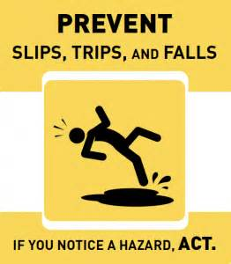

General Liability Claims
Trip/slip – falls (anywhere) resulting in bodily injury or property damage
Police cases; excessive force, false arrest, wrongful detention
Highway accidents not involving an insured vehicle (i.e. pothole claims, motor vehicle accidents due to weather or alleged road conditions)
Improper signage or View obstructions

Slide 28

NEW JERSEY TORT CLAIMS ACT
Also known as Title 59.
State statute that applies to all public entities in New Jersey.
The legislative response to the Supreme Court abrogating sovereign immunity in 1970.
The Act was effective July 1, 1972 and it re-establishes immunity as to negligence claims.
Sets forth the rules by which a person can pursue a municipality for civil damages.

Slide 29
TITLE 59 IMMUNITIES
Lack of prior notice (59:4-3)
Allocation of resources (59:2-3)
Dangerous conditions; whether “palpably unreasonable”; property must be used with due care and purpose for which it was intended (59:4-2)
Weather; must be sole cause of loss to apply (59:4-7)
Plan or Design (59:4-3)
Discretionary immunity; high level policy-making and planning decisions (59:2-3)
Inspection immunity (does not exonerate from failure to protect against a dangerous condition) (59:2-6)
Lack of permanent injury; requires objective proof of permanent loss of a bodily function that is substantial, by objective medical evidence rather than subjective complaints by the plaintiff (59:9-2)
Collateral source rule; all other insurance is primary (59:9-2)
Cannot subrogate against a public entity (59:9-2)
Unimproved land (59:4-8)
Escape of prisoner or injuries between prisoners (59:5-2)

Slide 30
Qual-Lynx LIABILITY CONTACT
Barbara Maclean, Liability Supervisor
Qual-Lynx
100 Decadon Drive
Egg Harbor Township, NJ 08234
bmaclean@qual-lynx
609-653-8400 x 2087

Slide 31

WORKERS’ COMPENSATION
Work Related Injury/Illness
JIF provides the maximum WC benefits allowed by law!

Slide 32

SOCIAL LEGISLATION
The New Jersey Workers’ Compensation Act was passed in 1911 and has been amended over the years.
Workers’ compensation is a system created by the New Jersey Legislature that provides benefits to workers’ who are injured or who contract an occupational disease while working.
Workers’ compensation is a “no fault” system. As a result, an injured worker is entitled to benefits under the Act regardless of his own negligence or that of a co-employee.

Slide 33

Workers Compensation
Statutory Benefits
Any injury to one of your employees arising out of and in the course of their employment for which medical treatment is required.*
Any injury to a police, fire or rescue volunteer, or other qualified volunteer as defined in the New Jersey Workers Compensation Act that arises out of and in the course of their public duty for which medical treatment is required.*
Any alleged occupational exposure (injury occurring over a period of time as opposed to a traumatic injury).
*If employee refuses medical treatment submit the claim as a “Report Only”.

Slide 34


WORKERS’ COMPENSATION BENEFITS
There are only three remedies in the NJ system of compensation: medical benefits, temporary disability benefits and permanent disability benefits.
MEDICAL TREATMENT
  Provide treatment with MCO panel physicians until employee is either discharged or reaches maximum medical improvement (MMI)
TEMPORARY TOTAL DISABILITY (TTD) – Wage Replacement
  TTD rates:
  2016 Maximum $871.00 Minimum $232.00
  2017 Maximum $896.00 Minimum $239.00
PERMANENT DISABILITY - EITHER PARTIAL (PPD) OR TOTAL (PTD)
  Depending on nature of injury, extent of treatment, and residual loss of function, a percentage of disability will be negotiated between all involved parties (injured worker, TPA/JIF, attorneys, and/or the judge)
  Settlements are paid (within JIF authority) with approval from Qual-Lynx

Slide 35
WORKERS’ COMPENSATION:
COMPENSABILITY
A claim that has been deemed work related and accepted is a compensable claim
To establish compensability, the adjuster investigates:
  An employment relationship
  An accident which “arose out of and in the course of” employment
  Causal relationship of an injury or medical condition to an incident or exposure at the work place
In NJ, an employer takes an employee “as is” with all ailments and infirmities (pre-existing issues)
N.J.S.A. 34:15

Slide 36

Workers’ Compensation Services
Managed Care
Intake and Initial Direction of Care
24/7 Claims Reporting Triage
Medical Case Management
QualCare Provider Network Access
Medical Bill Review and Repricing
Out-of-Network Rate Negotiation (MCCI)
Claims
Claim Management
Proprietary Claim Information Systems
Fraud Investigation Program
Litigation Management
Transitional Duty Program
Subrogation
Federal and State Reporting

Slide 37



ROLES
There are certain requirements for individual roles; however, sometimes the roles overlap.
All roles have to work together!

Slide 38

ROLES
Role of the Employee
Role of the Supervisor
Role of the Claims Coordinator
Role of the Intake Coordinator
Role of the Nurse Case Manager
Role of the Treating Provider(s)
Role of the Adjuster

Slide 39

ROLE OF THE CLAIMS COORDINATOR
It is the responsibility of the Claims Coordinator to oversee the reporting of claims within the municipality and serve as a liaison between the municipality, the Claims Administrator (TPA), and the Managed Care Organization (MCO).
Early, accurate claim reporting is essential to controlling the costs associated with your Workers’ Compensation claims.

Slide 40


Timely Reporting Is Key
In Workers’ Comp the Clock and Calendar are the Enemy
Success is Based on Good Communication
Injuries are best reported and attended to early
Claims reported more than three (3) days after the injury result in higher costs
Immediate care from an appropriate provider equals quicker recoveries. This translates into less lost time and lower indemnity and medical costs. This enables our Nurse Case Managers to direct care to one of our EPO Providers
Late reporting can lead to injuries becoming worse over time, complicating treatment and causing extra expense
Late reporting makes it more difficult to determine whether the injury occurred on the job
Late reporting jeopardizes the timely and thorough investigation of the claim

Slide 41

HOW DO I REPORT A
WORKERS’ COMPENSATION CLAIM
TO QUAL-LYNX?
Telephone
  Workers’ Compensation: 888-342-3839
Facsimile
Workers’ Compensation: 609-601-3196
Regular Mail
100 Decadon Drive, Egg Harbor Township, NJ 08234
Email
If you receive a Claim Petition, immediately send it to Patty Davidson at Qual-Lynx!

Slide 42
WHEN AN EMPLOYEE IS INJURED
Show genuine concern for the injured
employee’s welfare
Ensure First Aid has been administered
Do not use the emergency room unless
emergency treatment is required
Direct injured employee to authorized physician
If serious or catastrophic injury, call 911

Slide 43

WHEN AN EMPLOYEE IS INJURED
Gather basic information: date, place and time of injury; how the injury occurred; type of injury; social security number; name of witnesses; etc.
Call the Intake Department at 1-888-342-3839.
Tell the injured employee they will hear from an MCO representative to discuss medical care, or the TPA (an adjuster or supervisor), or both.

Slide 44
INTAKE PROCESS
Calls to the dedicated line, 888-342-3839, go directly to the Intake Department.
The Intake Coordinator determines who the caller is and identifies if the claim is report only or if treatment is required.
The Intake Coordinator interviews the caller to obtain the necessary information to complete the State of NJ First Report of Injury or Illness (FROI).
The toll-free number is available 24 hours a day, 7 days a week!

Slide 45

Do NOT use the Emergency Room unless Emergency Treatment is Required
Examples of Emergencies
Unconsciousness
Head Injury
Profuse bleeding
Unstable vital signs
Inability to move an extremity
Smoke inhalation
Eye trauma
****If serious or catastrophic injury, call 911****

Slide 46
Report Only
Report all incidents no matter how minor
Indicate “Refused Medical Treatment”
Tell employee that they MUST inform you if they later decide they need to see a doctor
Qual-Lynx will maintain a “suspense” file in case a claim for benefits later develops

Slide 47

REPORT ONLY vs. INCIDENT
REPORT ONLY CLAIMS
  If the claim is for reporting purposes only, the information is entered into our systems and a claim file is generated with a Qual-Lynx claim number
MEDICAL ONLY OR LOST TIME (INDEMNITY) CLAIMS
  The Intake Coordinator consults the MCO Nurse Case Manager Team Leader or Supervisor and/or the TPA Supervisor for direction of care.
  If the injured worker has trauma to their head, a NCM talks to the injured party to complete a head injury checklist. This is a 13-point questionnaire to determine if the claimant should be directed to the ER or to an Occupational Medicine Provider.
  Once care is directed, the Intake Coordinator schedules the employee and forwards an authorization and DDI to the provider.
  The Clinical Support Staff or NCM follows-up with the provider after the appointment to obtain the medical records and determine if further treatment is needed. The records are provided to the Adjuster for review.

Slide 48

WHEN AN EMPLOYEE IS INJURED
Gather basic information: date, place and time of injury; how the injury occurred; type of injury; social security number; name of witnesses; etc. (see FAR).
Call the Intake Department at 1-888-342-3839.
Tell the injured employee they will hear from an MCO representative to discuss medical care, or the TPA (an adjuster or supervisor), or both.
After calling the Intake Department to report the claim and managed care intake process is complete, a claim number is generated and the claim is put in my Workflow.
I(or my Assistant Supervisor)reviews the claim and assigns an adjuster.

Slide 49
NURSE CASE MANAGEMENT TRIGGERS
Claims involving loss of 8 or more days from work
Claims involving a transitional duty designation for more than 21 days
Claims involving causality or any other initial “red flag”
Claims involving a repeat workers’ compensation claimant (case by case basis)
Claims where an MRI or other significant study is ordered, where a nurse case manager was not previously assigned
Claims not meeting any of the above criteria but at the direction of the JIF or Claims Adjuster/Supervisor

Slide 50


ROLE OF THE NURSE CASE MANAGER
Communication
Provide updated treatment plan and work status to Adjuster and Employer after every visit
Communicate with Injured Worker and Provider about appointments, plan of care and work status
Direct Clinical Support Staff to schedule appointments, therapy, or diagnostic testing for authorized services
Review cases with Adjuster at scheduled Large Loss Meetings or Roundtable Discussions

Slide 51
ROLE OF THE
CLINICAL SUPPORT STAFF
Clinical Support Staff provide support to the Nursing Team and Medical Only Adjusters by performing necessary clerical duties.
Schedules medical appointments
Schedules initial physical therapy evaluation
Schedules diagnostic studies
Obtains and distributes medical notes and diagnostic reports
Enters pre-authorizations for when treatment is authorized by the NCM or Medical Only Adjuster
Faxes pre-cert and Duty Determination Instruction (DDI) form to providers

Slide 52



EPO – Exclusive Provider Organization
We have the largest provider network in New Jersey.
What do we hope to accomplish?
  Best of the best docs and facilities
  Preferred pricing
  Preferred service
  Providers Knowledgeable about Workers’ Compensation
  Communication
  Outcomes/Savings
  Quicker Return to Work
  Lower Cost

Slide 53
ROLE OF THE WC CLAIMS ADJUSTER
Once the claim is assigned, the adjuster must:
Contact the injured employee (for Lost Time cases only), employer, and nurse case manager or medical provider within 48 hours
Secure factual information to determine “compensability”
Review file for possible subrogation
Monitor medical treatment with assistance from a MCO representative to pursue a timely return to work, address causal relationship issues, and final discharge or MMI
Explore the possibility of transitional duty with the municipality
If employee is out of work, adjuster will verify the employee’s wages and obtain a 26 week wage statement. Once wages are verified, the adjuster will process wage replacement (TTD) checks, payable as directed by the employer
Adjuster will secure an increase in payment authority (if more than $10K is needed) from the JIF Executive Committee to pay all benefits, expenses, and legal associated with the claim
Monitor litigation if a claim petition is filed

Slide 54

EMPLOYER CONTACT
Verify injured employee’s job description
Confirm date of hire
Confirm work schedule/number of hours worked per week
Did the injured employee lose any time from work? If yes, what was the first day out of work?
Has the injured employee returned to work?
Does the municipality have transitional duty available?
Confirm the dates of disability and wages
Obtain 26 week wage statement (date of injury back 26 weeks)
Has the injured worker had any prior work injuries?
Keep employer/insured updated on medical status

Slide 55
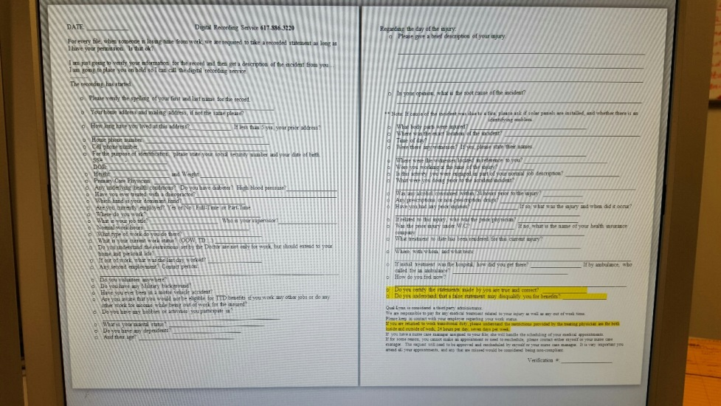
EMPLOYEE CONTACT
Verify to whom the injured employee reported the work injury
Obtain employee’s medical history
If claim was reported late, why?
Confirm facts of the incident; how occurred; where occurred; any witnesses
Confirm employment
Question injuries received and mechanics of injury
Question previous injuries
Does the injured employee have a second job or any side jobs?
Confirm the name and address of the employee’s family physician
Does the employee have any questions?

Slide 56

ROLE OF THE SUPERVISOR
Maintain contact with the injured employee by periodically contacting them and express support.
The main reason injured employees retain lawyers is because they are uncertain of their benefits or concerned that they are not receiving adequate medical treatment.
Determine the “root cause” of the accident.

Slide 57
SUPERVISOR’S INCIDENT REPORT
Root Cause Analysis
Immediately have the Supervisor’s Incident Report completed
Make certain the injured employee provides a detailed description of how the injury occurred:
  Slip/Trip – what caused the fall; ice, water, waxed surface, electric cord, raised sidewalk, etc.?
  Fall from height – ladder, truck, height?
  Fall forward, backward, strike body part; which body parts?
  Defective equipment?
  Where did injury occur (employer’s premises or private/ commercial venue)?

Slide 58

SUPERVISOR’S INCIDENT REPORT
Did the supervisor physically inspect the location of injury?
Any unsafe or unusual hazards present?
Did employee alter equipment being used?
Evidence of horseplay, intoxication, drug use?
Was employer provided safety equipment in use? If yes, was it being used properly?
Any suspicions about how the accident/injury occurred?
Are you satisfied the accident/injury occurred as the employee described?

Slide 59

RED FLAGS
    Reported Late
    Specific Details Cannot Be Recalled
    Accident Not Witnessed
    Secondary Employment
    Incident Occurs Following Day(s) Off
    Witness Accounts Inconsistent With Employee’s Version
    Fails To Attend Appointments
    Not Home When Tried To Be Reached or During GOTCHA Calls

Slide 60


Slide 61
TRANSITIONAL DUTY
    Studies have shown that many injured employees are capable of assuming their full responsibilities at an earlier date if they start a transitional plan before reaching MMI
    Nurses and Adjusters remind providers of availability
    Doctor evaluates the injured worker for capability and sets forth work restrictions
    Employer is notified
    Employer determines availability
    Second Effort
    Employer informs employee outlining alternative duty and sets a time for re-evaluation (not open-ended)
    Employee re-evaluated at next provider visit
    Transitional duty either continues or the employee is returned to full duty

Slide 62

About Transitional Duty
Serves as a “bridge” to full duty
Cuts down on need for replacement employees
Has positive psychological effects
Pays off for you and employee
Repeated studies have shown that the longer a worker is off the job, the less likely it is that he or she will ever come back.
Notes:
NOTES:
_______________________________________________________________
_______________________________________________________________
_______________________________________________________________
_______________________________________________________________
_______________________________________________________________
_______________________________________________________________
_______________________________________________________________
_______________________________________________________________

Slide 63

More About Transitional Duty
Transitional Duty Policy
Educate supervisors, employees, physicians, and claims adjusters.
Spell out “temporary” nature of assignment
Have physician describe physical limitations
Work with your safety and claims professionals to develop your modified duty or early return to work program.
Notes:
NOTES:
_______________________________________________________________
_______________________________________________________________
_______________________________________________________________
_______________________________________________________________
_______________________________________________________________
_______________________________________________________________
_______________________________________________________________
_______________________________________________________________

Slide 64
G.O.T.C.H.A.
Go Out To Check Home Activities
This investigative tool is invaluable in terms of cost containment. Investigators conduct unannounced, personal visits to each “lost time” claimant if the injured worker is out of work more than 14 days (or three weeks after surgery).
The opportunity to interview injured workers in their homes provides us with detailed information to support telephonic investigation. These visits confirm or deny the existence of malingering or fraudulent activity, and often highlight other factors that may inhibit a claimant’s timely return to work. In addition, a GOTCHA visit can lead to surveillance, if warranted.

Slide 65

G.O.T.C.H.A. Program
Go Out To Check Home Activities
Backup verification of treatment, therapy, or surgery schedules.
Visits heighten the employee's awareness that their recovery and their claim are being monitored.
Investigator can detect "red flags" at home, which may not be apparent when personal contact has been made under other circumstances.
Visits strengthen the network of contact and reassures the claimant that the employer cares about his/her recovery and return to work
Unannounced visits may encourage an employee on the verge of recovery to get into the "return to work" mind set.
Surveillance will be ordered, if necessary.

Slide 66

M M I
Maximum Medical Improvement
Maximum medical improvement (MMI): Concept is when an employee is as fully restored as the nature of the injury will allow.
Alternate terms for MMI include “medical plateau,” “as good as you’re going to get” (not cured, not healed, not good as new – none of those things), “employee’s condition is not expected to improve any further.”
MMI is very important. It is the bright line that takes us from medical and temporary disability issues to permanency issues.
MMI on Day One does not mean MMI on Day 120.
The MMI opinion from the treating physician is only good on the date it was given.

Slide 67
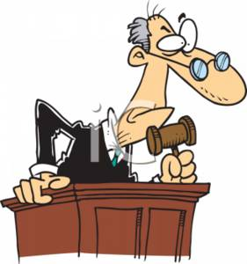
LITIGATION
WHAT IS A CLAIM PETITION
PERMANENCY EVALUATION
JUDGE OF WORKERS’ COMPENSATION
SETTLEMENTS
  ORDER APROVING SETTLEMENT
  SECTION 20 DISMISSAL
Once award is paid, file will be closed
Employee has 2 years from date of last benefit payment to reopen, unless dismissed

Slide 68


IF A CLAIM PETITION IS FILED
If the Member receives a Claim Petition (CP) it should be immediately forwarded to Patty Davidson via email pdavidson@qual-lynx.com or facsimile 609-601-3164.
If a CP is filed, the adjuster will notify the Fund Commissioner to advise of the CP and to confirm work status.
Adjuster will send CP, copy of the file, and an assignment letter directly to a panel approved defense counsel who will file the appropriate answer.
Adjuster will maintain contact with defense attorney for claim resolution (additional investigation, permanency evaluations, settlement negotiations).
Adjuster will secure appropriate authority from the JIF Executive Committee for settlements beyond its’ authority level.

Slide 69

WHEN DOES A WORKERS’ COMPENSATION CASE END?
If no Claim Petition is filed:
  Confirm all authorized treatment has concluded
  MMI obtained
  RTW established and employee is back at work or unable to work due to permanent restrictions
  All outstanding medical bills that Qual-Lynx has received have been paid
  Confirm there is no potential for subrogation
  File is then closed (the injured employee has two years from the date of last benefit to reopen their claim)
If a Claim Petition is filed: litigation commences

Slide 70

Recording and Reporting of Occupational Injuries and Illnesses
OSHA 300
All public employers must maintain records of all work-related injuries or illnesses
Report all fatalities or employee hospitalization within 8 hours
(800) 624-1644
Contact JIF Safety Director for additional details or assistance.

Slide 71

Helpful Hints
Be sure to keep a copy of all information sent to Scibal to Qual-Lynx
Whenever an employee approaches you regarding workers compensation benefits for an alleged injury, immediately report the claim to Qual-Lynx using the toll free telephone number and complete the Supervisor’s Incident Report. Reporting the claim to Qual-Lynx does not automatically make the employee eligible for benefits.
Any time you feel there are questionable circumstances surrounding the claim, contact Qual-Lynx immediately.
Call in Workers Compensation claims to Qual-Lynx as quickly as possible (preferably the day they are reported to you), whether treatment is needed or not.
If there is an accident (near miss) involving one of your employees which does not require medical care, a Supervisor’s Incident Report should still be completed and kept at the municipality for record purposes.

Slide 72



COMMUNICATION
Employee
Adjuster
Nurse Case Manager
Treating Provider(s)
Clinical Support Staff
Claims Coordinator
Supervisor
We’re all in this together!

Slide 73
Qual-Lynx WC CONTACT
100 Decadon Drive, Egg Harbor Township, NJ 08234
Patty Davidson, WC Supervisor
pdavidson@qual-lynx.com
609-653-8400 x 2104
Tammy Langsdorf, WC Assistant Supervisor
tlangsdorf@qual-lynx.com
609-653-8400 x 2097

Slide 74
Qual-Lynx MCO CONTACT
100 Decadon Drive, Egg Harbor Township, NJ 08234
Karen Beatty, Client Services Manager
kbeatty@qual-lynx.com * 609-653-8400 x 3201
Peggy Holmes, NCM Team Supervisor
pholmes@qual-lynx.com * 609-653-8400 x 3210
Russ Bayer, NCM Team Leader
rbayer@qual-lynx.com * 609-653-8400 x 3204

Slide 75

QUESTIONS???

